Slide 1


Slide 2



This course material by Osama Salah is released under the following license:
Attribution-ShareAlike 4.0 International (CC BY-SA 4.0)
Conditions for use are published here:
https://creativecommons.org/licenses/by-sa/4.0/

Slide 3
Acknowledgement
I would like to thank and acknowledge the following people for their valuable contributions to this course material:
Have your name and effort acknowledged here!!!

Slide 4
FAIR Open Course Module 6 – Results Presentation Ver. 0.1 / Last Update: 14/09/2019

Slide 5
Risk Analysis Report

Slide 6
Scenario
Introduction
The information security risk management office was approached by the CEO on concerns triggered by the increased reporting on ransomware in the news. The objective of the risk analysis is to investigate the following scenario and provide management with the necessary information to support decision making.

Slide 7
Scenario
The Scenario
Analyze the risk associated with cyber criminals attacking our campaign material repository using ransomware to encrypt the data and locking out workstations.
Objective
Determine how risk will change if we implemented mitigating controls.

Slide 8
Assumptions
We treat ransomware as any other malware.
Ransomware encrypts the files and locks workstations.
Organization is not specifically targeted. This is an opportunistic attack.
Organization will not pay ransom.
There is no free decryption tool available.
50 workstations are critical for continuing to operate.
Existing controls: Antivirus and Backup

Slide 9
Risk Analysis Team
IT Manager (Cyber Security SME)
Information Security Engineer (Cyber Security SME)
Operations Manager (Risk Owner, Business Impact Estimates)
Senior HR Officer (Employee Productivity)
Finance Manager (Revenue)
Risk Analyst (Facilitator)

Slide 10
The FAIR Model
Not used
$
Input
Risk
Loss Event Frequency
Loss Magnitude
Primary Loss
Secondary Risk
Secondary Loss Event Frequency
Secondary Loss Magnitude
Resistance Strength
Threat Capability
Vulnerability
Probability of Action
Contact Frequency
Threat Event Frequency
Output
#
$
$
$
%
$

Slide 11
The Data (Estimates)
How often do we expect a ransomware event to occur in the next 12 months?
Rationale:
Subject matter experts based their estimates on the current malware infection rates observed in the organization in the past twelve month.
They also took into account ransomware trends published by leading security vendors.
Loss Event Frequency
Min | ML | Max
2 | 3 | 5

Slide 12
Primary Losses
Primary Losses considered only the 50 employees supporting the critical processes.
Primary Loss | (min/ ml/ max)
Productivity The cost incurred by staff being unproductive or less productive than normal. | $34,560 / $64,800 / $115,200
Replacement The cost to replace the hard disks in the workstations and return them into working condition. | $2250
Response The cost to hire additional IT support staff for support during the recovery activities. | $9,600 / $12,800 / $16,000

Slide 13
Secondary Losses
Reputation: How often do we expect to lose future business as a result of bad reputation and losing customers' trust and what is the likely impact?
The probability of loosing future business was rated as relatively low. It is estimated as a percentage of current business volume (as estimated by Operations, Marketing and Finance Manager)
SLEF (%)
Min | ML | Max
2% | 3% | 5%
Secondary Loss Magnitude
Reputation | $300K, $450K, $900K

Slide 14
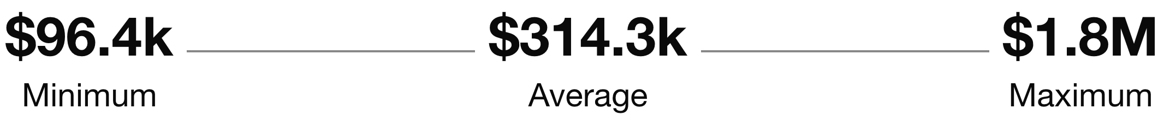
Results
Should a ransomware event occur we believe the losses will on minimum be about $96K and not exceed $1.8M, however on average we estimate it to be around $314K.
There is a 20% probability that losses will exceed $370K.
The majority of losses will be incurred due to the potential loss of future business, rather than the costs to incurred directly from the ransomware such as response and recovery.

Slide 15
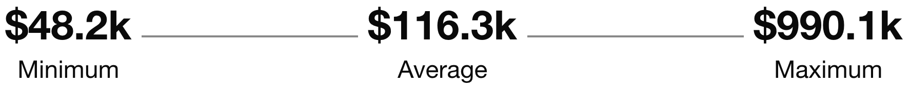
Mitigation Option
With an annual investment of approx. $50K into a new endpoint protection solution we can reduce the likelihood of a loss event occurring.
The impact on our loss exposure is as follows:

Slide 16
Details
In this section you can share some annualized loss exposure charts, loss exceedance curves etc. if you feel it will be useful.
Alternatively, just compile that information to have it handy if you are asked for more details.

Slide 17
Note
The FAIR-U app has it’s limitations. Other information you could share would be the expected losses where 10% to 90% of loss events occur.
 | Min | 10% | Average | 90% | Max
Risk | $96.4 | $203 | $314.3k | $924K | $1.8M
Treatment 1 | $48.2K | $87 | $116.3K | $459 | $990.1K
Treatment 2

